Slide 1
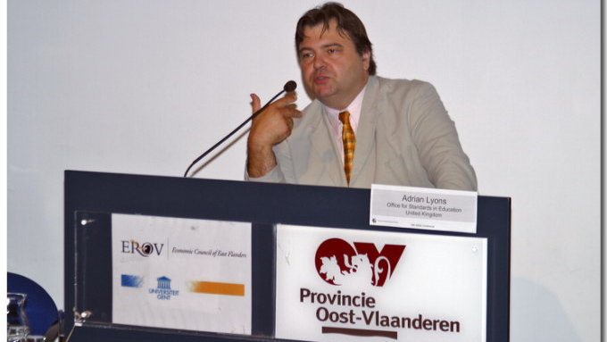
Knowledge is not the enemy of Enterprise
Adrian Lyons, formerly Her Majesty’s Inspector and Ofsted’s (the English school inspectorate) national lead for economics, business and enterprise.

Slide 2



Slide 3

The importance of the curriculum
“Twelve years of education should give children a lot more than a disposition to learn and some ill-defined skills. Yet the evidence from the first stage of our research this year is that the focus on substance, on the knowledge that we want young people to acquire, is often lost…
…If their entire school experience has been designed to push them through mark-scheme hoops, rather than developing a deep body of knowledge, they will struggle in later study.”
Notes:
The key focus that HMCI pointed out in regard to the curriculum
knowledge to be acquired
deep body of knowledge.
The following slides – 7-11 highlight these points through the important aspects of the findings from the research on curriculum

Slide 4
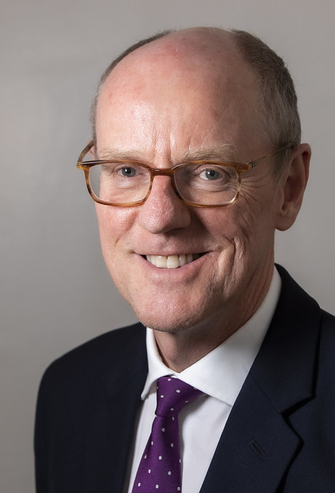
But what sort of curriculum?
Nick Gibb MP the Minister of State for Schools in England explained in an article in FE news why he is committed to a ‘knowledge rich’ curriculum: ‘My belief, and my argument today, is that we will only deliver on the promises that all politicians make, of ensuring that every child receives a first-class education, if we ensure that all our children are taught:
In schools with an extensive knowledge-rich curriculum by well-trained and supported teachers;
In schools where strong discipline means pupils are taught in a safe and caring environment, with high expectations and where success is rewarded and celebrated;
In schools that develop character and resilience;
In schools that encompass the arts, languages, music and the humanities as well as science and maths;
In schools that give every child the knowledge they are entitled to as part of their cultural inheritance.’
This Photo by Unknown Author is licensed under CC BY-NC-ND

Slide 5
The English Bacc
English
Mathematics
Science
History or Geography
A Modern Foreign Language
No place for Technology, Creativity (music, art), economics, business etc.
It is an accountability measure for schools but not for students.

Slide 6
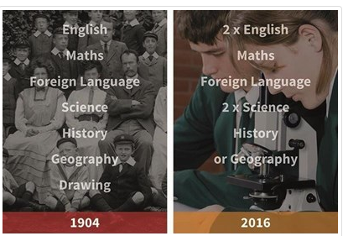

Slide 7
Knowledge vs Skills
under the current ideology knowledge is good and skills are bad. This has led to some unhelpful assumptions regarding enterprise education as enterprise has too often been seen as only about skills.

Slide 8
But Ofsted’s definition of Enterprise is:
Since 2005, Ofsted has consistently used a definition of enterprise education which is: ‘Enterprise education is enterprise capability supported by better financial capability and economic and business understanding’ i.e. it is about developing skills, but very much underpinned by knowledge and understand. We have consistently criticised an over-emphasis on skills, (innovation, creativity, risk-management and risk-taking, a can-do attitude and the drive to make ideas happen) when as is so often the case, this is not set in a context of providing pupils with economic, business and financial knowledge and understanding. Ofsted’s 2005 report ‘Developing Enterprising Young People’, commented that: ‘Most schools are good at identifying opportunities for enterprise learning in the curriculum but are less good at identifying what students are expected to achieve from these experiences.’

Slide 9
So what economic and business knowledge and understanding do we want students to have?
Consumer knowledge and understanding
Producer knowledge and understanding
Citizenship knowledge and understanding
Over to you!

Slide 10
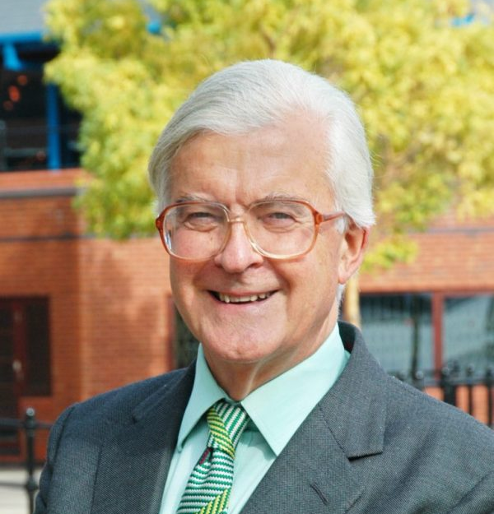
The architect of the national curriculum says the current EBacc is ‘regressive’, ‘severely limits learning’, ignores the skills needed for today’s workforce, and fails poorer students.
The government’s EBacc measure should be broadened into a “new Baccalaureate” including opportunities for computer science, creative and technical subjects, the architect of the national curriculum has said.
Lord Kenneth Baker, in his role as chairman of the Edge Foundation, has published a report criticising the government’s current target to have 90 per cent of students studying the EBacc.

Slide 11
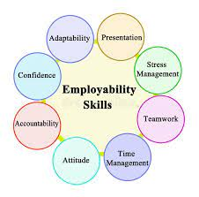
So what economic and business knowledge and understanding do we want students to have?
Consumer knowledge and understanding
Producer knowledge and understanding
Citizenship knowledge and understanding
Financial Literacy
Employability Skills
(e.g..

Slide 12
Returning to 2005
The 2005 report went on to identify as a problem the lack of involvement of business and economics specialist teachers in the delivery of enterprise citing two reasons being:
‘enterprise education is seen as being only about the development of generic skills such as problem solving and creativity with little attention given to economic and business understanding or financial capability
there is a mistaken belief that economic and business understanding and financial capability can be taught by anyone’.

Slide 13
2008 Ofsted report on Financial Education
‘Financial capability requires an understanding of the key terms and ideas associated with personal finance, the skills to make sensible financial decisions and the development of appropriate attitudes to managing money. Young people must acquire not only factual knowledge but also an appreciation that there are often no ‘right’ answers because decisions depend on individual circumstances and preferences. For example, the decision whether to take out fully comprehensive car insurance requires an understanding of different types of insurance and their comparative risks and benefits. However, the decision taken will vary between individuals according to the value they place on the car, their financial circumstances and how they assess risk.’ (Developing Financially Capable Young People, Ofsted 2008)

Slide 14
Ofsted’s 2011 report ‘Economics, Business and Enterprise Education’ found that:
The schools visited did much to promote students’ enterprise capability by a whole range of often highly engaging and wide-ranging provision in this area. As a result, in more than half of the schools visited, students were developing good problem-solving and teamworking skills, including negotiation, cooperation, planning and organisation.
However, in the secondary schools, economic and business understanding, and financial capability were not as well developed and were often weak. As a result, students often had only vague ideas about the economy, interest rates and their impact, recession, inflation, why prices vary and the ownership of companies.

Slide 15
The report picked up on previous concerns regarding teachers’ lack of subject knowledge:
‘Many of the teachers deployed to deliver aspects of enterprise education were non-specialists, who had little or no training or experience of this area. This limited their confidence and ability to teach effectively. This was particularly the case in relation to economic and business understanding and financial capability for students in the secondary schools.’

Slide 16


